Slide 1

Backpropagation
Sigmoid (x)=1/(1+e^{-x})

Slide 2
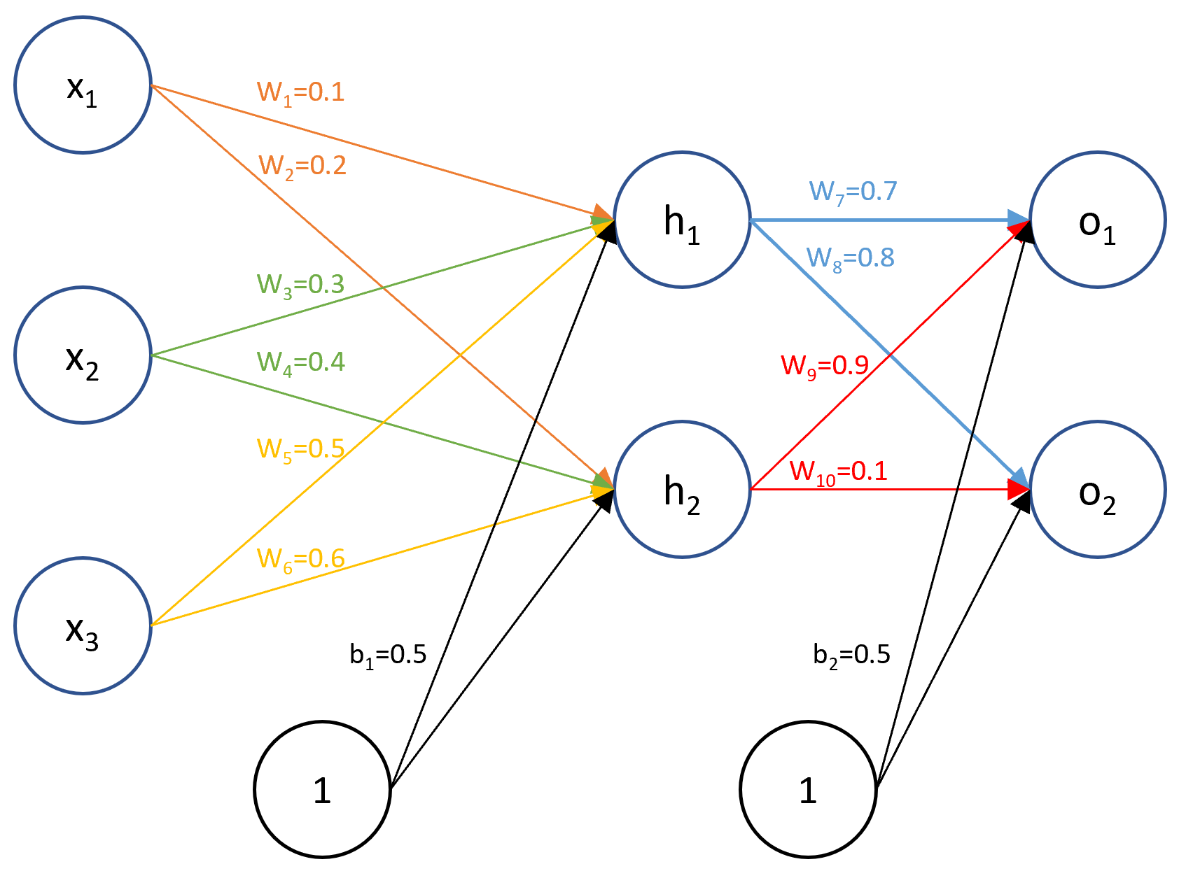
Y₁
Y₂

Slide 3
h1
1- Compute the dot products for each hidden node call It z
2- Apply sigmoid on z call it h1
Y₁
h2
1- Compute the dot products for each hidden node ayer call It z
2- Apply sigmoid on z call it h2
Y₂

Slide 4
y1
1- Compute the dot products for each output node call It z
2- Apply sigmoid on z call it y1
Y₁
y2
Y₂
1- Compute the dot products for each output node call It z
2- Apply sigmoid on z call it y2
h1-0.9866
h2- 0.9950
y1=0.8896
y2=0.8004

Slide 5
Error Min square
Y₁
E=1/2[(y1-true_y1)² + 1/2(y2-true_y2)^{2]}
Y₂
Y1 is the predicted
True_y is the expected
Assume
True_y1=0.1
True_y2=

Slide 6
Backpropagation
Is based on derivative

Slide 7
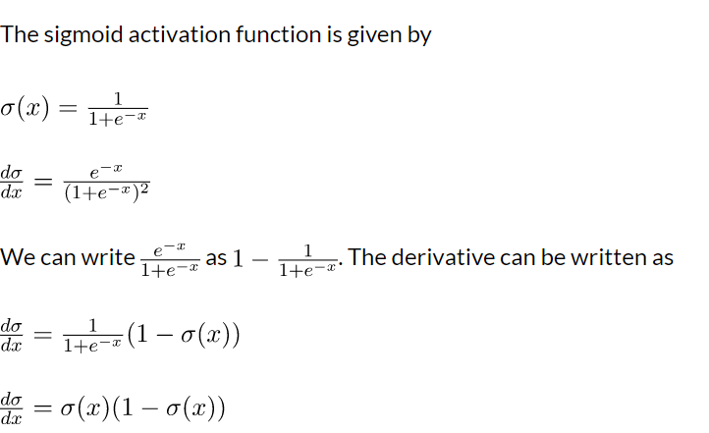
Recall: derivative of sigmoid function

Slide 8
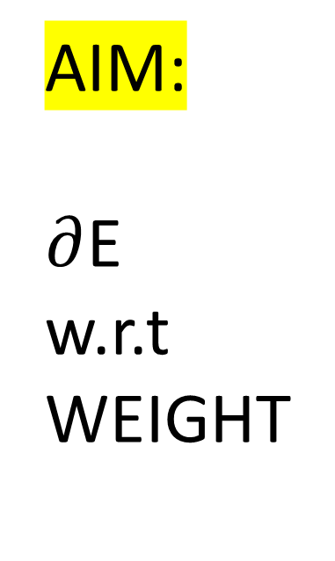
AIM:
$∂$E
w.r.t
WEIGHT

Slide 9
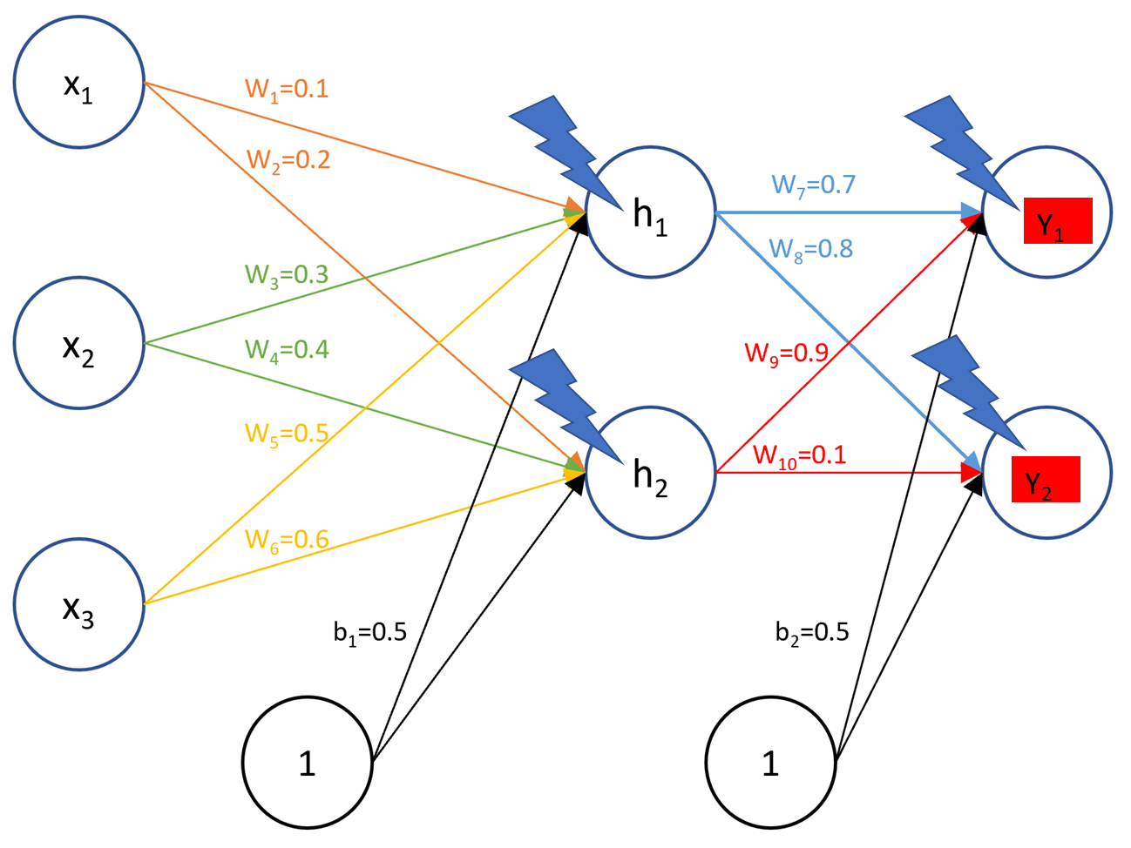
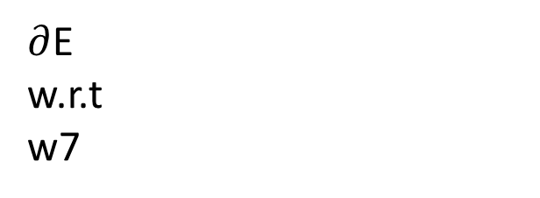
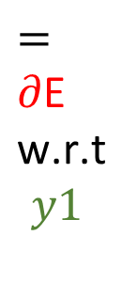
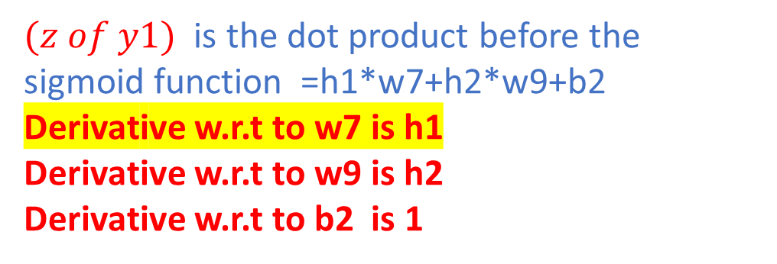
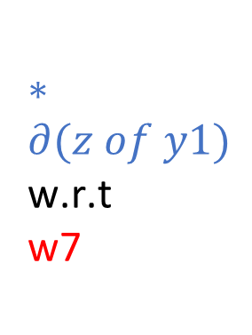
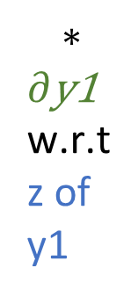
$∂$E
w.r.t
w7
$∗∂(z of y1)$
$\text{w}\text{.}\text{r}\text{.}\text{t}$
w$\text{7}$
$=∂\text{E}$
$\text{w}\text{.}\text{r}\text{.}\text{t}$
$$y1$$
$$∗$$
$∂\text{y}\text{1}$
$\text{w}\text{.}\text{r}\text{.}\text{t}$
z of y1
$(z of y1)$ is the dot product before the sigmoid function =h1*w7+h2*w9+b2
Derivative w.r.t to w7 is h1
Derivative w.r.t to w9 is h2
Derivative w.r.t to b2 is 1

Slide 10
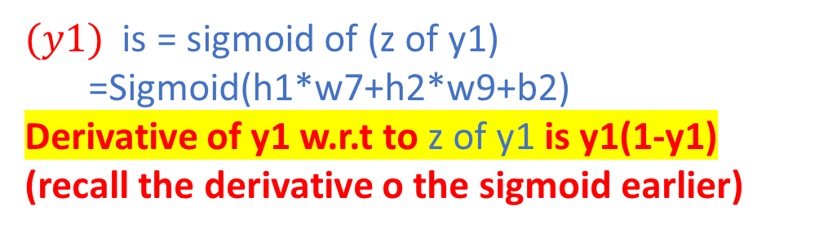
$∂$E
w.r.t
w7
$∗∂(z of y1)$
$\text{w}\text{.}\text{r}\text{.}\text{t}$
w$\text{7}$
$=∂\text{E}$
$\text{w}\text{.}\text{r}\text{.}\text{t}$
$$y1$$
$$∗$$
$∂\text{y}\text{1}$
$\text{w}\text{.}\text{r}\text{.}\text{t}$
z of y1
$(y1)$ is = sigmoid of (z of y1)
=Sigmoid(h1*w7+h2*w9+b2)
Derivative of y1 w.r.t to z of y1 is y1(1-y1)
(recall the derivative o the sigmoid earlier)

Slide 11
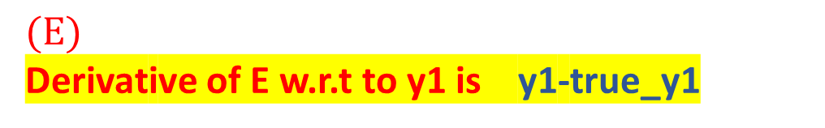
$∂$E
w.r.t
w7
$∗∂(z of y1)$
$\text{w}\text{.}\text{r}\text{.}\text{t}$
w$\text{7}$
$=∂\text{E}$
$\text{w}\text{.}\text{r}\text{.}\text{t}$
$$y1$$
$$∗$$
$∂\text{y}\text{1}$
$\text{w}\text{.}\text{r}\text{.}\text{t}$
z of y1
$(E)$
Derivative of E w.r.t to y1 is y1-true_y1
=1/2[(y1-true_y1)² + 1/2(y2-true_y2)²

Slide 12

Compute the Derivative of Error with respect to w7 if
True_y1=0.1 (verify it =0.0765)
$∂$E
w.r.t
w7
$∗∂(z of y1)$
$\text{w}\text{.}\text{r}\text{.}\text{t}$
w$\text{7}$
$=∂\text{E}$
$\text{w}\text{.}\text{r}\text{.}\text{t}$
$$y1$$
$$∗$$
$∂\text{y}\text{1}$
$\text{w}\text{.}\text{r}\text{.}\text{t}$
z of y1
E=1/2[(y1-true_y1)² + 1/2(y2-true_y2)^{2]}
Derivative of E w.r.t to y1 is y1-true_y1
Derivative of y1 w.r.t to z of y1 is y1(1-y1
Derivative of z of y1 w.r.t to w7 is h1

Slide 13
3
Derivative of z of y1 w.r.t to w7 is h1
2
Derivative of y1 w.r.t to z of y1 is y1(1-y1
1
Derivative of E w.r.t to y1 is y1-true_y1
Y₁
E=1/2[(y1-true_y1)² + 1/2(y2-true_y2)^{2]}
Y₂
Multiply 1*2*3= the gradient

Slide 14
the new w7 = w7-0.01*the Gradient 0.01 is the learning rate verify that the new w7 is 0.6992

Slide 15

Next compute
W8-w9-w10

Slide 16
Compute all the weights

Slide 17
3
Derivative of z of h1 w.r.t to w1
2
Derivative of h1 w.r.t to z of h1 ??
1
Derivative of E w.r.t to h1 ??
Y₁
E=1/2[(y1-true_y1)² + 1/2(y2-true_y2)^{2]}
Y₂
Multiply 1*2*3= The gradient

Slide 18
The new w1 = w1-0.01*the Gradient
0.01 is the learning rate verify that the new w1 is 0.1000

